Slide 1




Citizen Science
What is it and how can you get involved?

Slide 2





Today’s Agenda
Introductions
What is Citizen Science?
How to Get Started
Taking a Closer LOok
Wrap-Up

Slide 3

What comes to mind when you hear the phrase citizen science?

Slide 4
What is citizen Science?

Slide 5
A collaboration between scientists and those of us who are curious, concerned, and motivated to make a difference.
It’s how people can make an impact on issues they care about...and help science!
Citizen Science

Slide 6
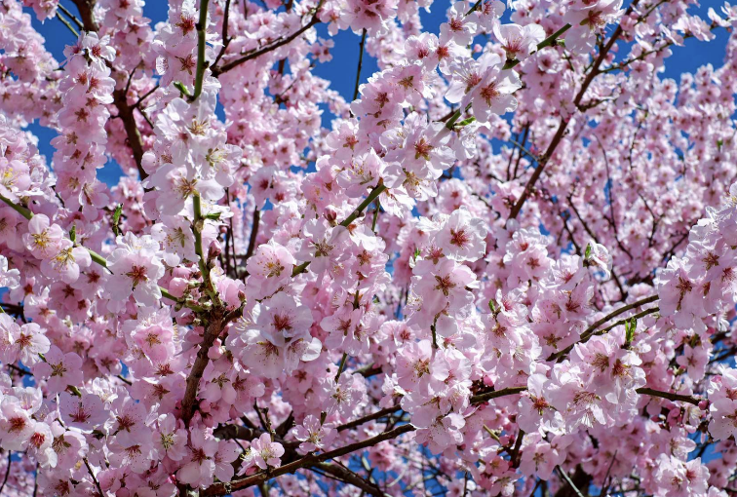
Imagine this tree in your neighborhood.
What do you notice?
How many leaves do you see in relation to flowers?
Do you see buds on the branches?
Are the flowers in full bloom or are some wilted?

Slide 7
You just participated in citizen science!
You just shared observations that scientists can use to research climate change or the appearance of destructive invasive species, and that city planners might use to better understand tree canopies and heat effects.

Slide 8
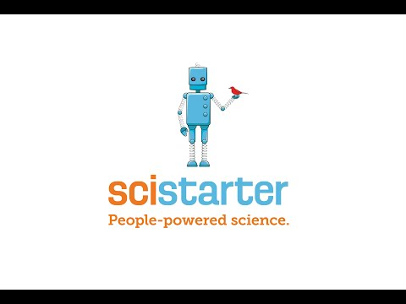
Notes:
https://www.youtube.com/watch?v=a-JIo4MgNMo

Slide 9
Why is it important?

Slide 10
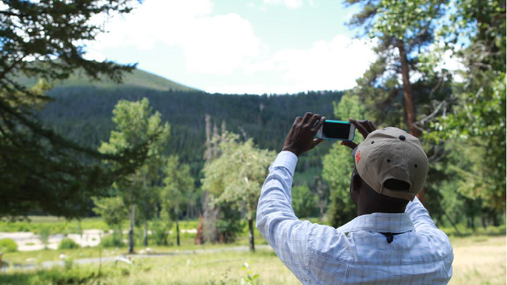
Because of citizen scientists, we now know….
Bird populations have declined by 50%
Birds are breeding earlier
50+ types of bacteria live in your belly button
The first flowering of 19 species of plants has moved 9 days earlier over the past decade
There’s a new type of aurora in the night sky (and the citizen scientists named it Steve!)
There’s another Jupiter-sized planet
Invasive mosquito species have arrived in Germany

Slide 11
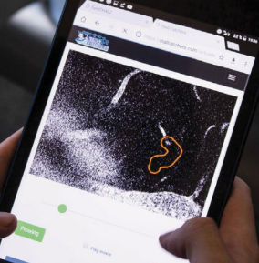
Plus!
In one weekend in 2019, citizen scientists accomplished 2,566 research hours, or 3.5 months of lab-equivalent research time, for an Alzheimer’s research project.

Slide 12
Who can do citizen science?

Slide 13
Citizen scientists are typically people without specialized training who participate in scientific research to help answer questions that cannot be answered without their help.

Slide 14
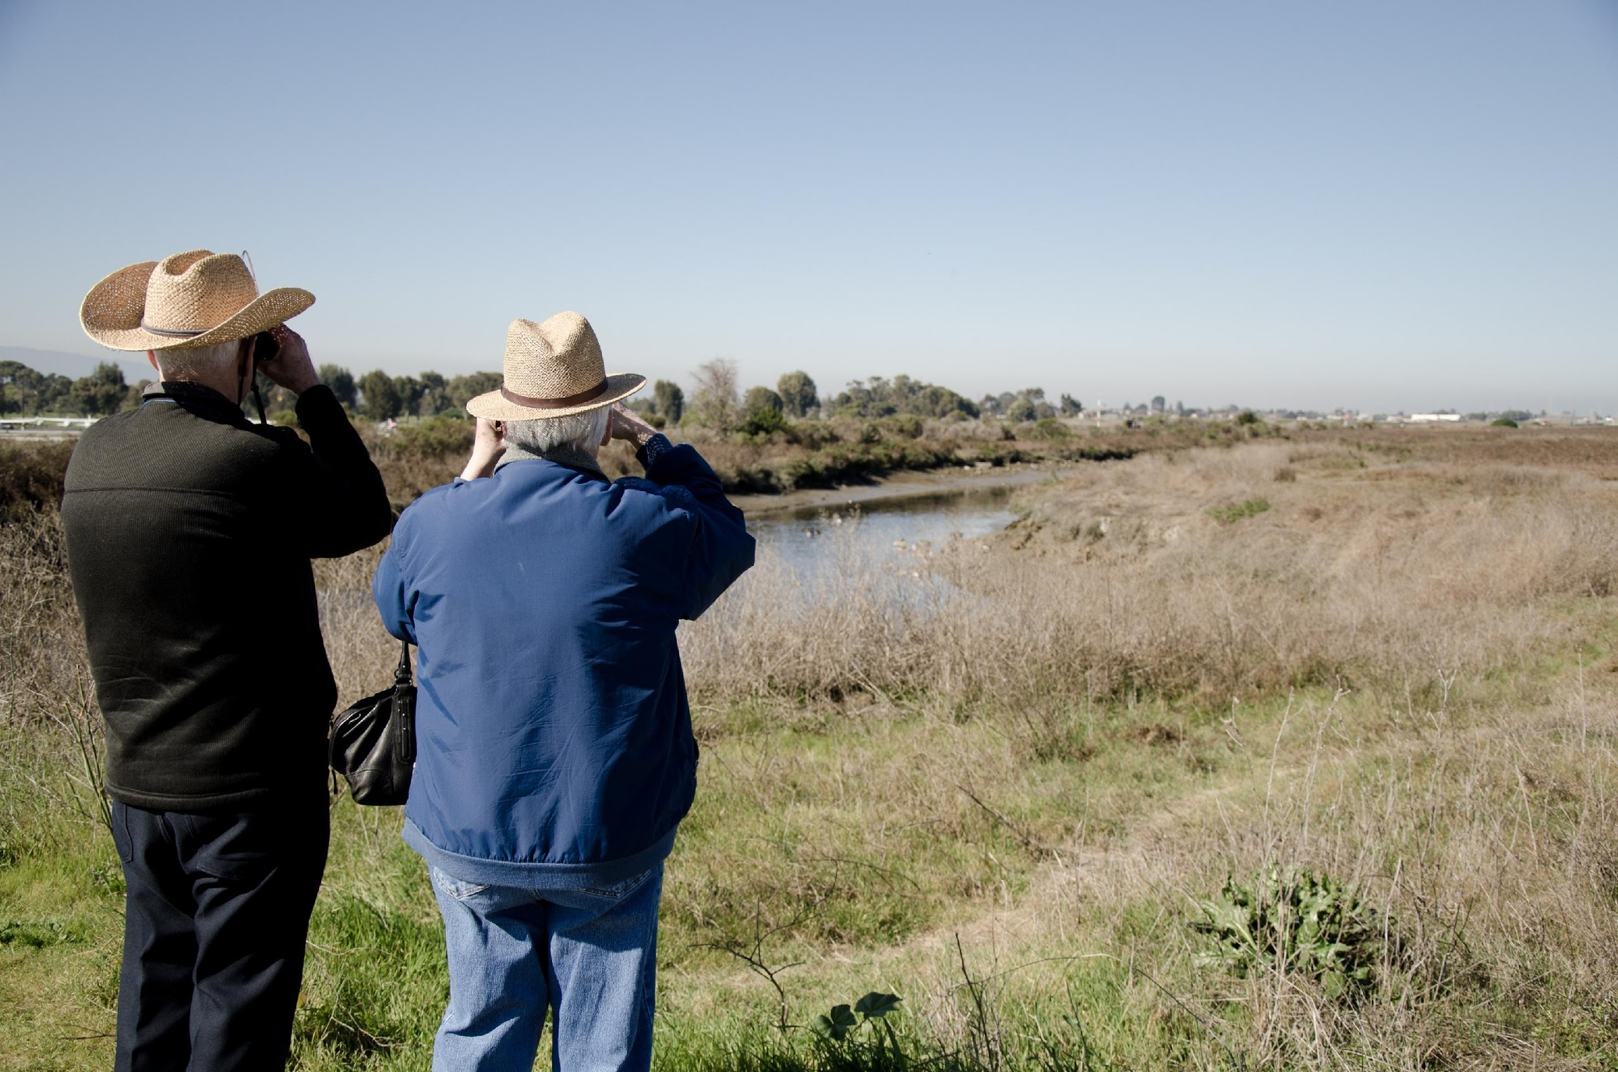
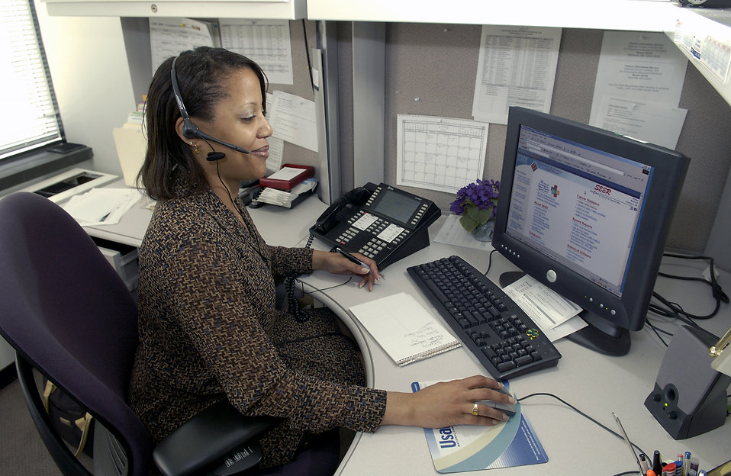
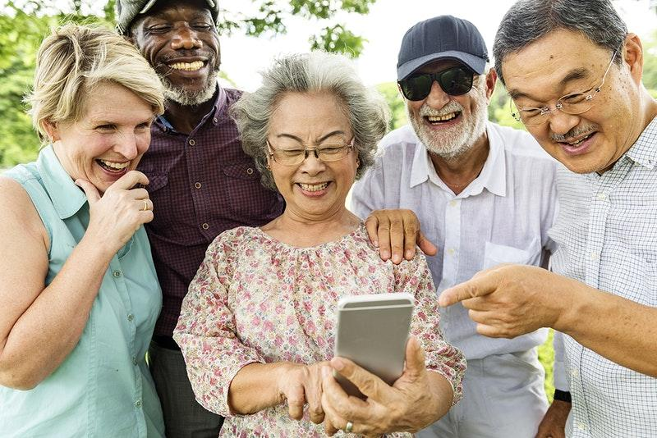
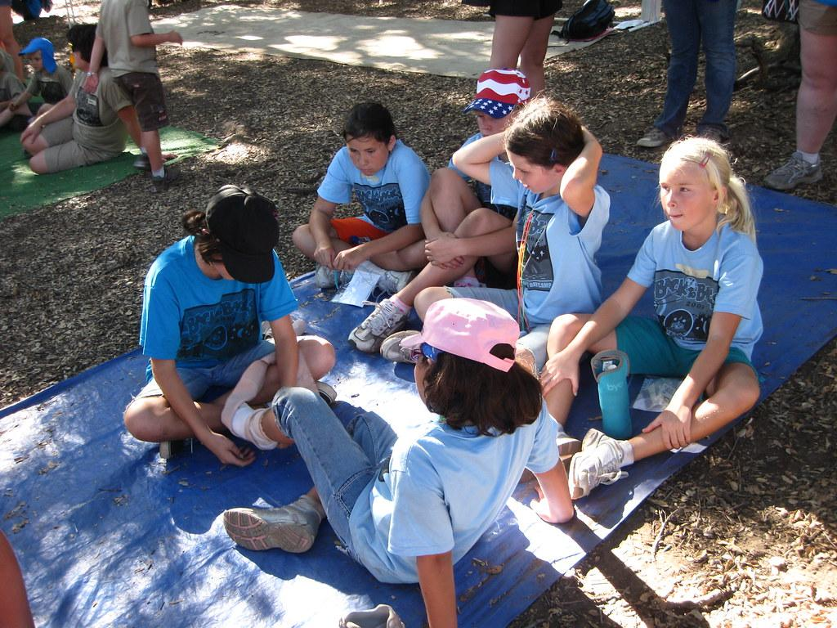
Retired people
Busy working adults
The answer is anyone!
Youth groups
Community Groups

Slide 15
How do you get started?

Slide 16
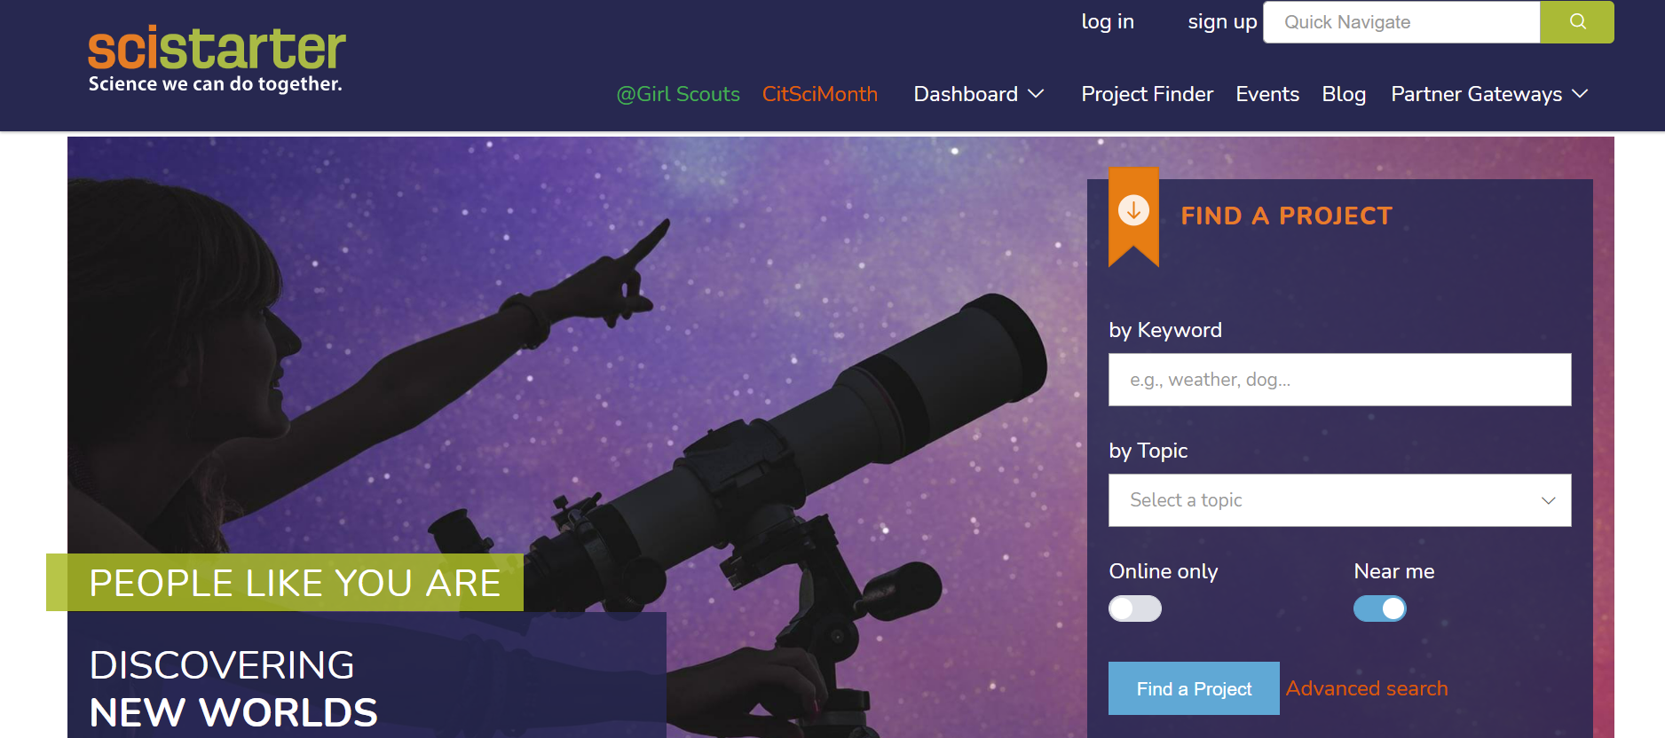
Step 1: Join SciStarter.org
SciStarter is a globally acclaimed, online citizen science hub where more than 3,000 projects from all over the internet have been organized and made searchable!
Notes:
A research affiliate of Arizona State University (ASU), SciStarter hosts an active community of over 100,000 registered citizen scientists and millions of additional site visitors.

Slide 17
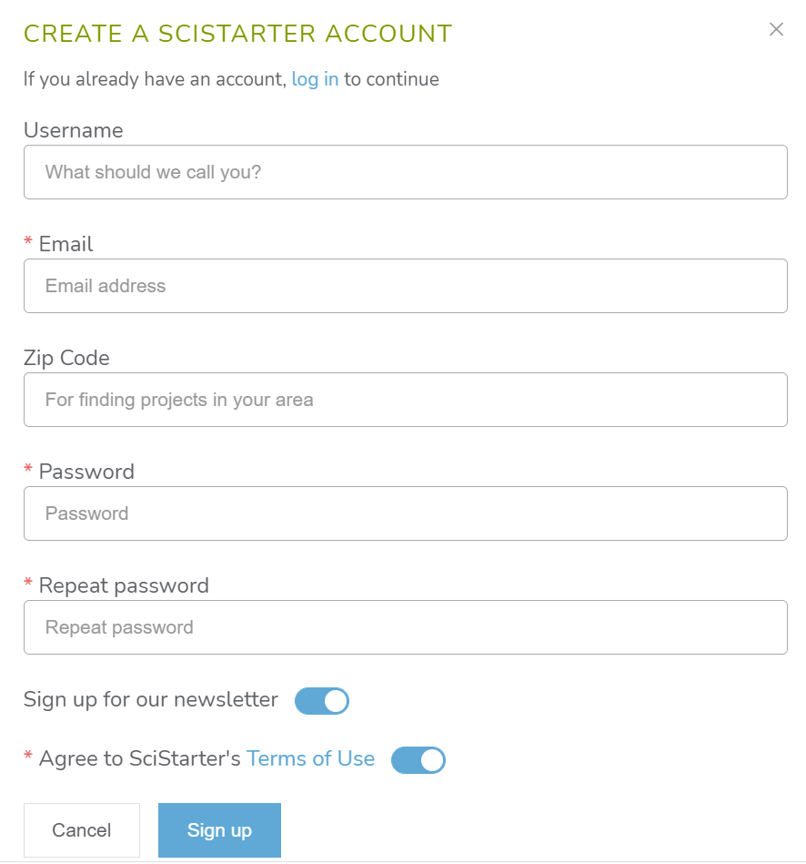
Create an account

Slide 18
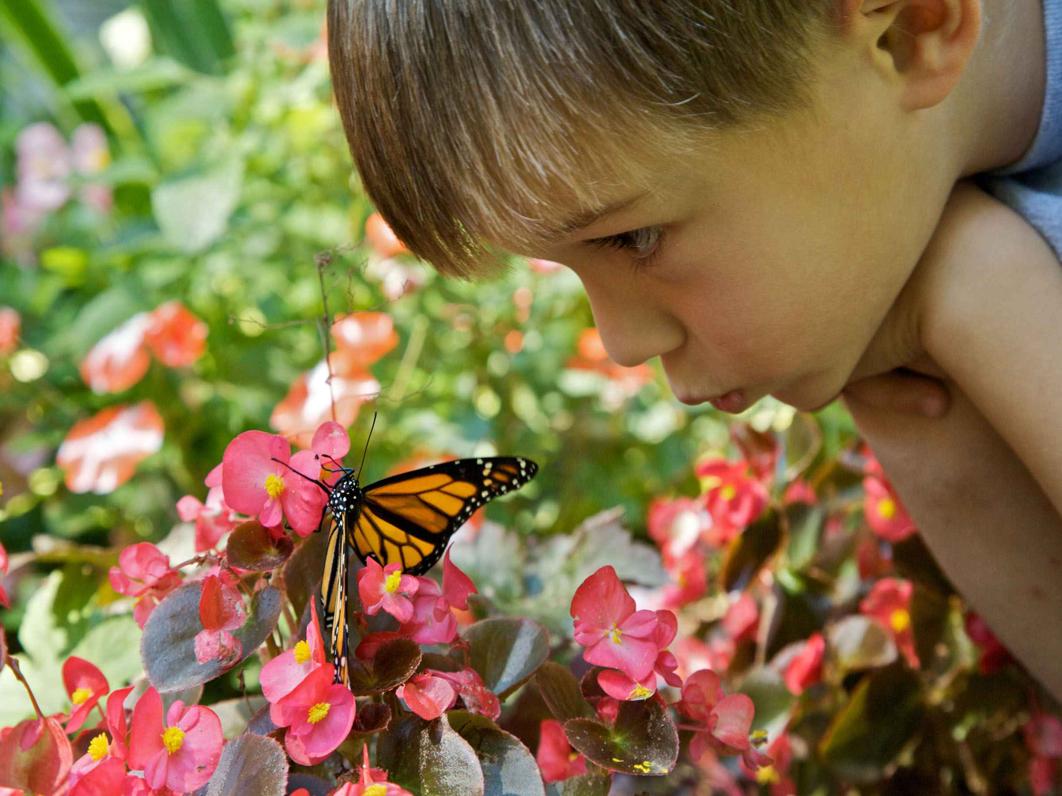
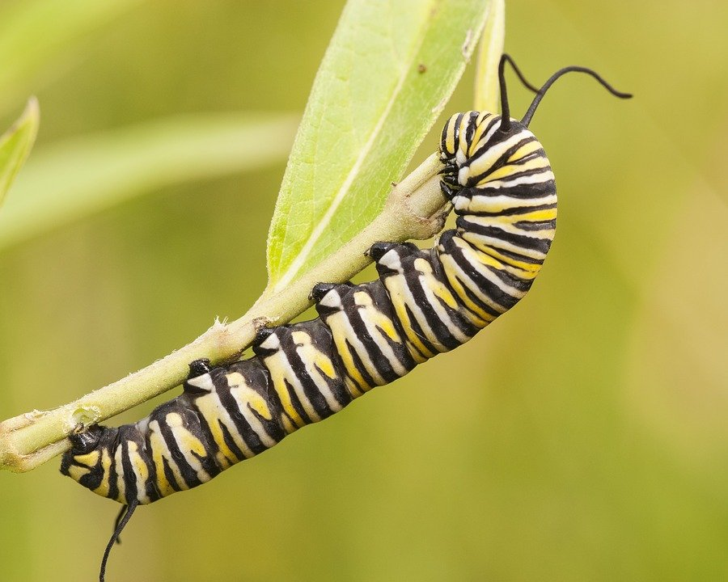
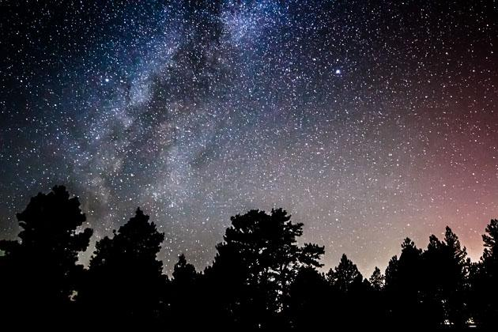
Find projects that interest you!
The Great Sunflower Project
Document pollinators in your community.
Caterpillar Counts
Measure seasonal variation by counting arthropods.
Globe at Night
Monitor light pollution.
Anywhere. Anytime. Any topic.

Slide 19
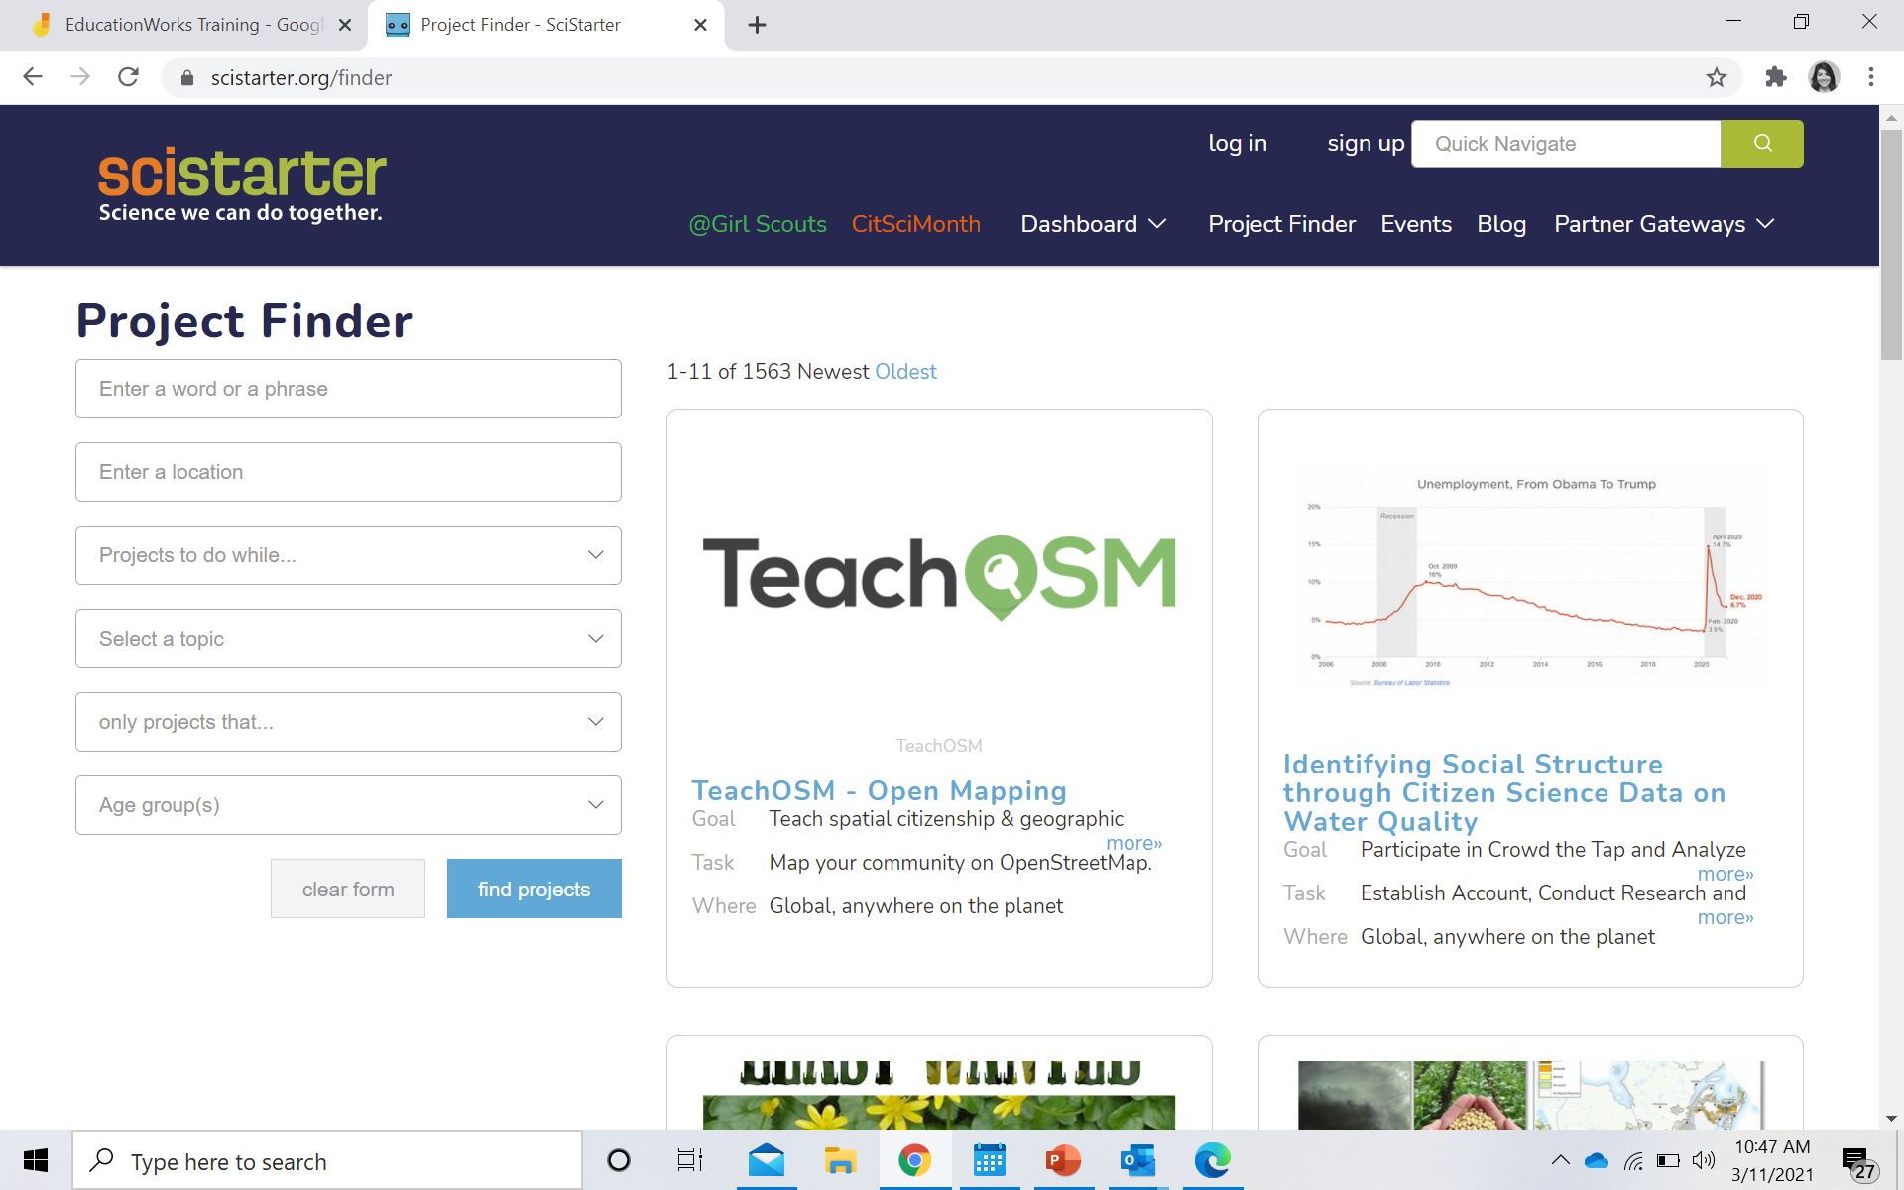
Step 2: Search SciStarter.org/finder
The projects and events on SciStarter.org represent a wide array of topics and research programs that participants from diverse communities and backgrounds can engage in anywhere, anytime, just once or on an ongoing basis.
Notes:
SciStarter offers people guidance and support with projects, tools and resources to successfully engage in citizen science.

Slide 20
What skills do I need to do citizen science?

Slide 21
Asking Questions
Observing
Communicating Results
When you do citizen science you are using science process skills.
Science Process Skills
Analyzing Data
Collecting Data
Reporting Data

Slide 22
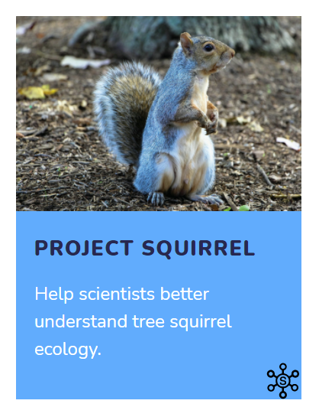
Taking a Closer Look

Slide 23
Asking Questions
Let’s Reflect
What skills did you practice while completing Project Squirrel?
Observing
Communicating Results
Science Process Skills
Analyzing Data
Collecting Data
Reporting Data

Slide 24
Asking Questions
Let’s Reflect
What skills did you practice while completing Project Squirrel?
Observing
Communicating Results
Science Process Skills
Analyzing Data
Collecting Data
Reporting Data
Notes:
The scientist didn’t ask you to analyze the data or communicate the results to other in this project. But every project offers opportunities to take it further. For example in Project Squirrel allows you to explore further, by data, analyze and interpret it and share results with your own community. Don’t feel limited by what the project scientist asks of you.

Slide 25

Let’s try a project!
https://media.scistarter.org/stallcatchers-demo/SCDemo_p1.html
Play a game to accelerate Alzheimer's research. Let’s try!

Slide 26
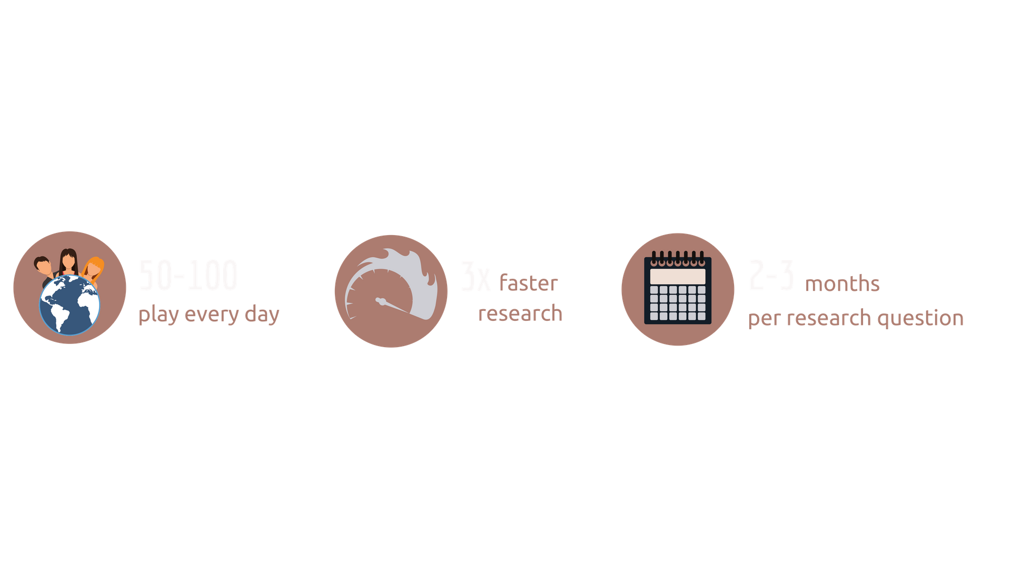

Enter Stall Catchers!
>28 000
catchers
50-100
play every day
5x faster
research
1-2 months
per research question

Slide 27
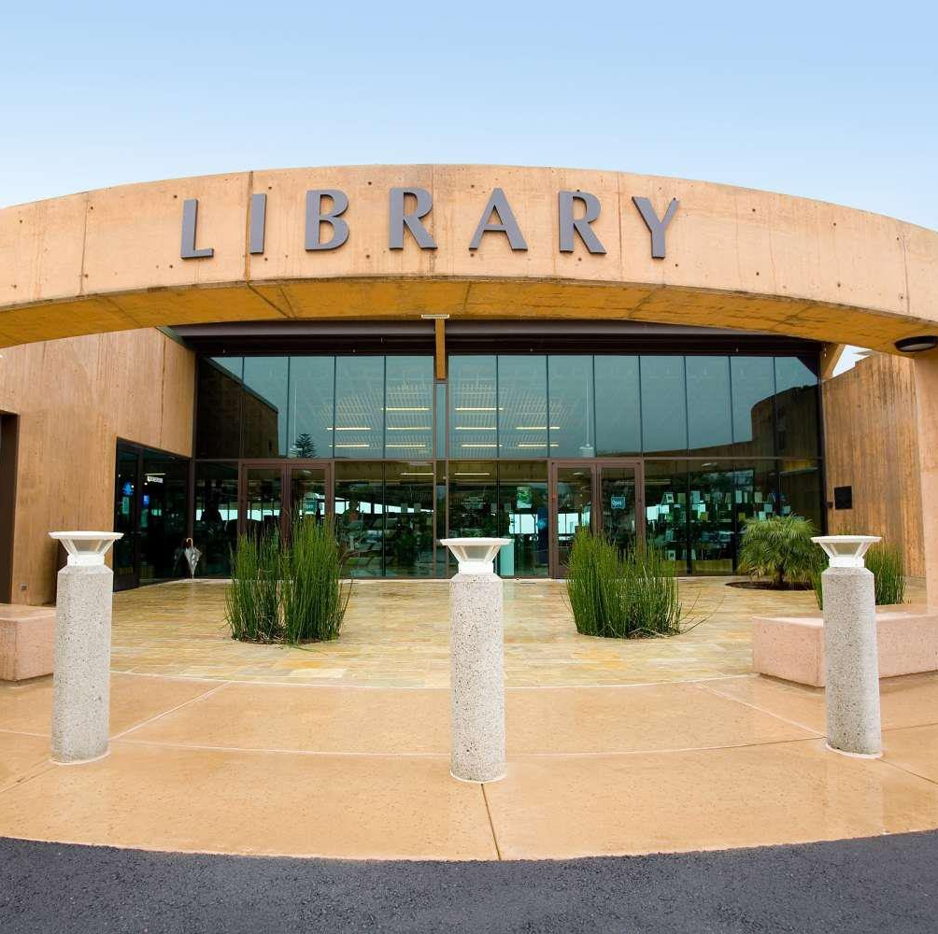
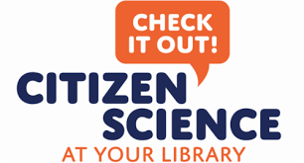
Many libraries across the country are becoming hubs for citizen science, where you can access books, field guides, computers, Wi-Fi, subject matter experts, telescopes and other citizen science resources.
Some libraries are even housing Citizen Science Kits with specialized tool to check-out that can help you complete a project!
Visit SciStarter.org/Library for more information.

Slide 28
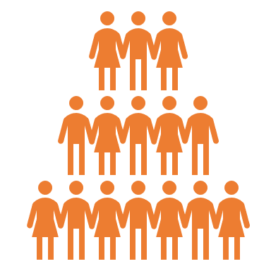



Benefits to Science & Society
Citizen science enables people from all walks of life to actively learn more about the world and address issues they are curious or concerned about.
BROADENS THE SCOPE OF WHO CAN CONTRIBUTE TO SCIENCE.
ENABLES PARTICIPANTS TO ENGAGE IN DATA COLLECTION, ANALYSIS, AND INTERPRETATION.
ENABLES PARTICIPANTS TO LEARN ABOUT THE NATURE OF SCIENCE AND SCIENTIFIC REASONING.
ACCELERATES IMPORTANT RESEARCH AND DISCOVERY.

Slide 29
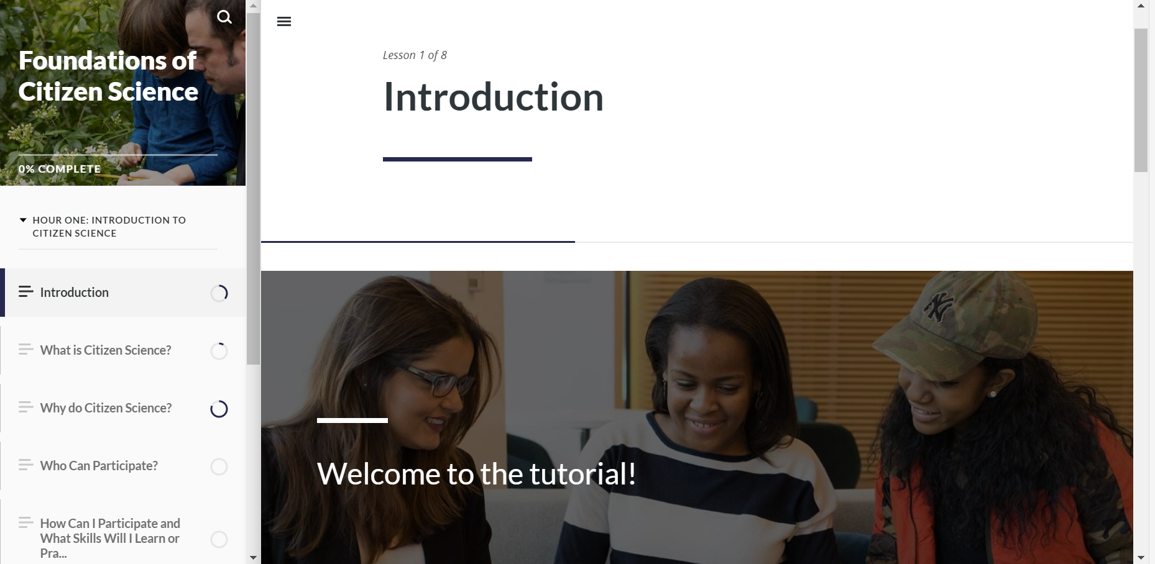
Now you’re ready!
Complete the Foundations of Citizen Science Training and earn a badge.
Visit SciStarter.com/Training for more information.

Slide 30
Questions?

